Slide 1
Leveraging Sales Analysis and Predictive Modeling: Unveiling Insights for Enhanced Online Retail Performance
Group 4
Shah Dhairyav Jatin
Likhitha Varakala
Manmitha Pantangi

Slide 2
Data Source
Obtained from Kaggle, our dataset encompasses online sales in the United States, providing a comprehensive overview of sales trends and patterns.
The dataset covers a wide range of products, including diverse merchandise and electronic items, enabling analysis across various industries and product categories.
Sales data is collected from different states, allowing for regional analysis and identification of geographical sales patterns and preferences.

Slide 3
Why Sales Forecasting?
Strategic Decision-Making: Sales forecasting enables informed strategic decision-making by providing insights into future demand trends and market conditions.
Resource Allocation: Accurate sales forecasts help optimize resource allocation, including inventory management, production planning, and staffing, leading to cost savings and improved operational efficiency.
Proactive Planning: Sales forecasting allows businesses to proactively plan marketing and sales strategies, identify potential challenges, and capitalize on emerging opportunities, resulting in increased competitiveness and profitability.

Slide 4
Data Preprocessing
We conducted a comprehensive examination of the dataset to ensure its quality and integrity before analysis.
To ensure consistency and ease of use, we modified column names using regular expressions, removing spaces, dots, and symbols.
Certain columns, such as 'order_date' and 'year,' were converted to appropriate data types (datetime and year) for meaningful analysis.
We extracted month information from the 'month' column, creating a new column with formatted month abbreviations.

Slide 5
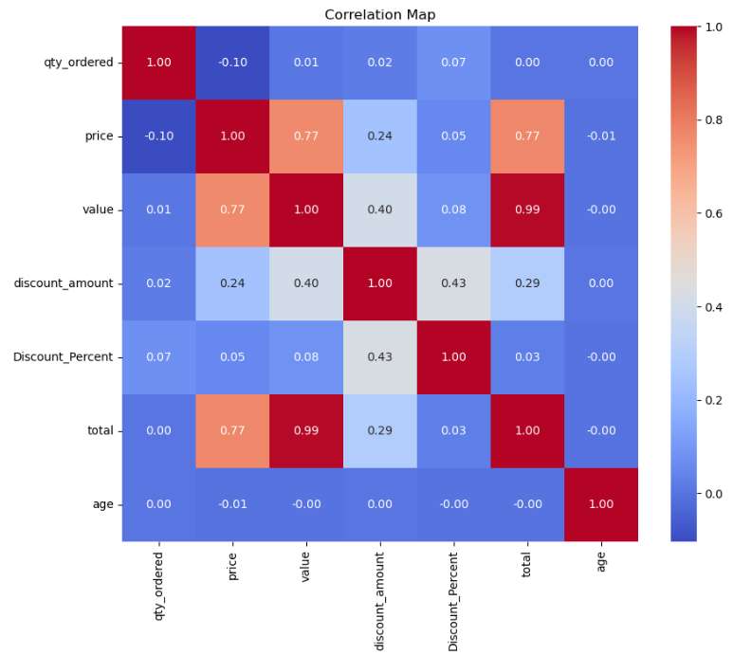
Feature Selection
Based on the correlation map, the most important features to predict total sales are:
Price
Discount amount
Discount percent

Slide 6
Predictive Models
Random Forest
Decision Tree Regressor
XGBoost

Slide 7
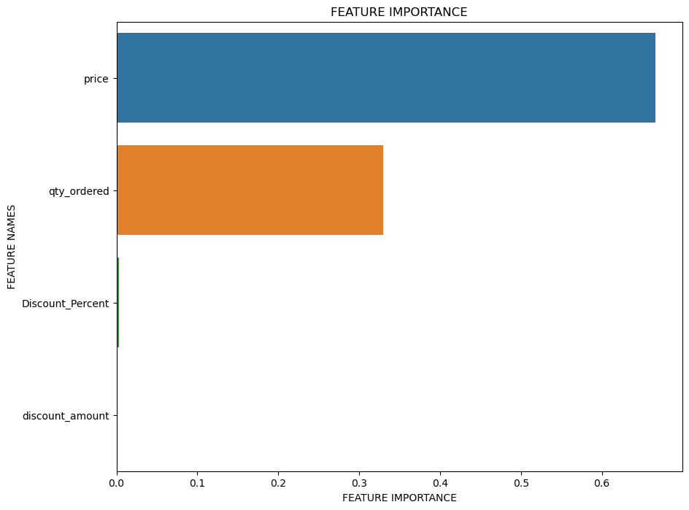
Random Forest
We trained a Random Forest regressor with 100 estimators using the training data, leveraging ensemble modeling for more accurate predictions.
Mean squared error - 3646.10
Root mean squared error - 60.38
R-squared value - 0.9991

Slide 8
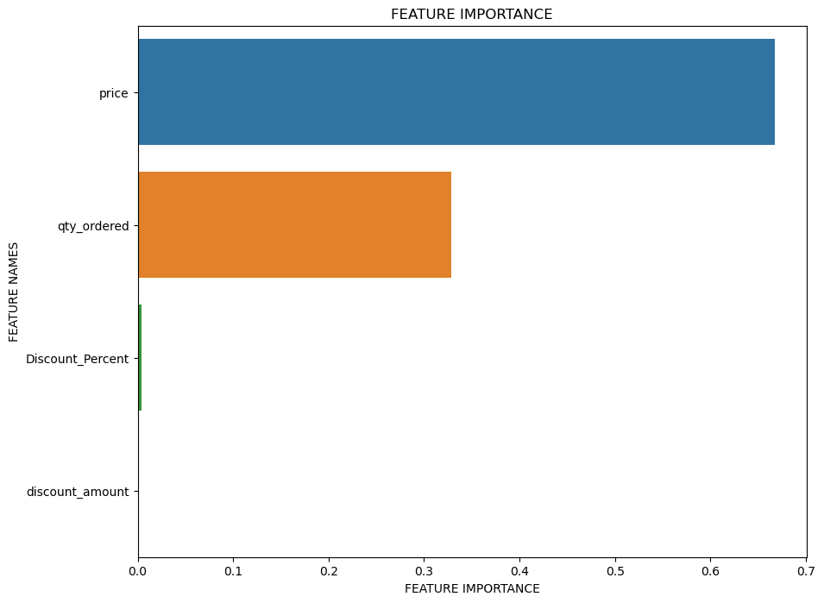
Decision Tree Regressor (before Hyper Parameter Tuning)
We trained a Decision Tree Regressor using the training data and evaluated its performance by making predictions on the test data.
Mean Squared Error: 7011.71
Root Mean Squared Error: 83.73
R-squared: 0.998

Slide 9
Decision Tree Regressor (with Hyper Parameter Tuning)
We conducted hyperparameter tuning for the Decision Tree Regressor using a random search with cross-validation to enhance its performance.
The best-performing model had the following optimal hyperparameters:
min_samples_split=2, min_samples_leaf=1, max_features='auto', and max_depth=None.
Mean Squared Error: 5675.13
Root Mean Squared Error: 75.33
R-squared: 0.99

Slide 10
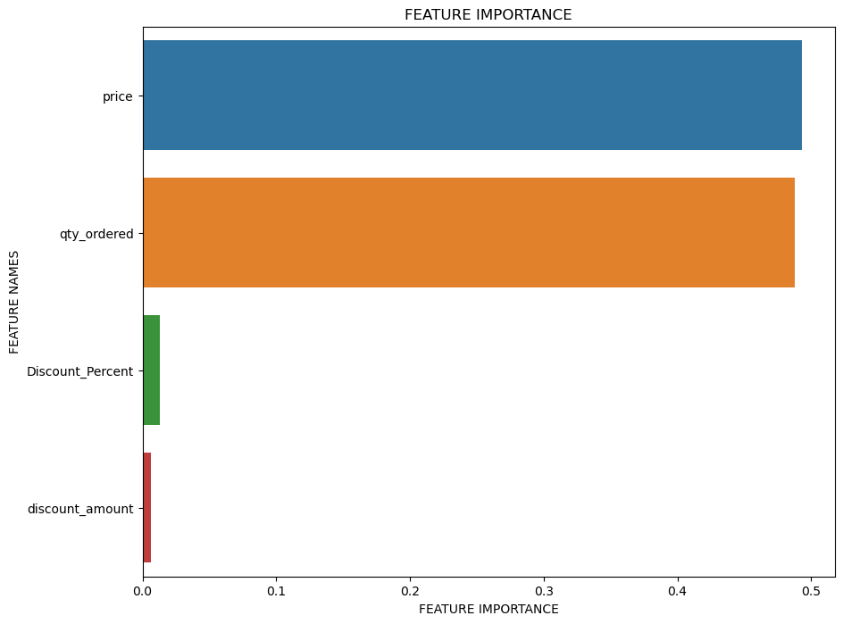
XG Boost
We trained the XGBoost model using the training data and made predictions on the test data to evaluate its performance.
Mean squared error - 1800.61
Root mean squared error - 42.43
R-squared value - 0.9995

Slide 11
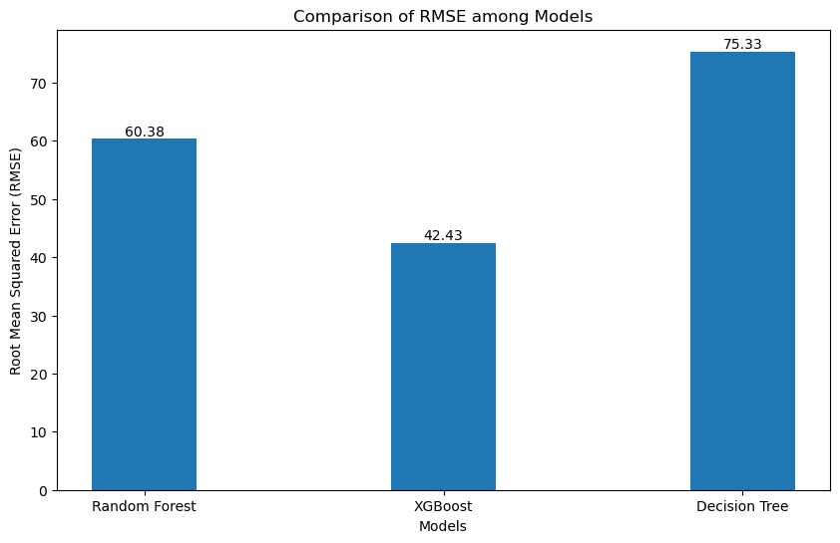
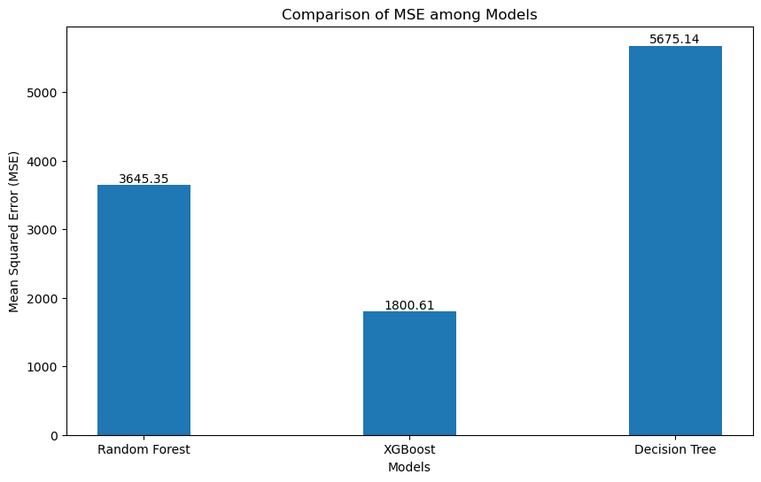
Comparison of models
XGBoost demonstrated greater performance in terms of both mean squared error (MSE) and root mean square error (RMSE)

Slide 12
Recommendations
Pricing Strategy: Align pricing with customer expectations and market trends to maximize profitability.
Inventory Management: Monitor popular product categories like "Mobiles & Tablets" closely and ensure sufficient stock levels to meet demand.
Marketing and Promotions: Strategically plan marketing campaigns and promotions based on sales patterns over time, targeting peak periods and offering discounts during off-peak periods.
Payment Options: Offer diverse and secure payment options, including popular methods like COD and digital payment gateways, to cater to customer preferences.
Predictive Analytics: Implement predictive analytics models, such as XGBoost, for accurate sales forecasting and optimization of inventory, resource allocation, and overall business strategy.

Slide 13
Thank You

